Slide 1
What’s that?
A concept app by Team That.
Adam, Eduardo, and Joseph

Slide 2
What is “What’s That?”
“What’s That” is a fun mobile app that allows you to learn more about the world around you. The user simply takes a picture of an object, structure, essentially anything, and the app will provide detailed information on what it thinks the image is. What’s that also works for sounds / music you would like to know more about.

Slide 3
Features of What’s That
Able to identify structures / objects E
-Using advanced image recognition, we would be able to figure out the object that is being shown and provide a detailed explanation.
Able to identity sounds / songs E
-What’s That would be able to recognize unknown sounds that is being picked up, if you’re looking for music “What’s That” would be able to help you find it.

Slide 4
Features of What’s That
Community Boards
Users can create boards to discuss any image they upload to discuss their upload. This board will also be linked to any other boards on the same object.
Logging System
Any time the app can not identify an image it will attempt to find what the user was looking for and prompt them to create an unknown item board so other users can help find out what it is, once identified the board can be submitted to be added to the greater database.
Trending Boards E
Trending boards will show the top trending boards of the week. (Can be filtered to show trending of day, week, month, year)

Slide 5
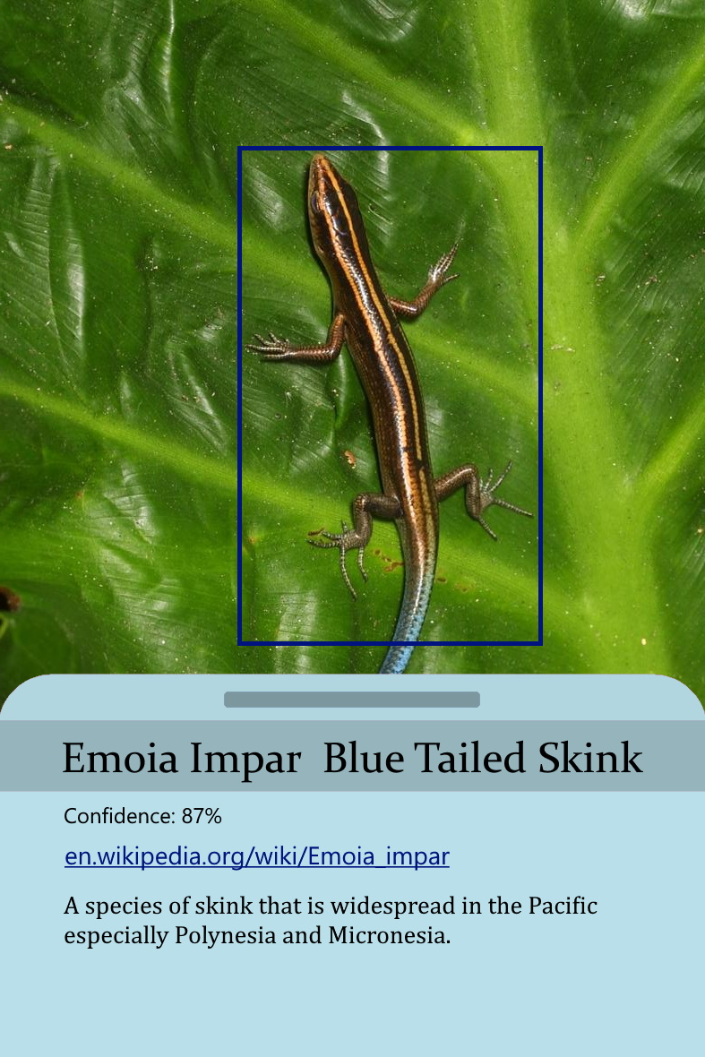
A simple UI example of the app identifying an image.

Slide 6
Availability
“What’s That” would be available for Android, IOS and as a Website.

